Slide 1
Cycle 2 Group 3
SKY RACERS
Thomas Gadek, Nicholas Knowles, Emmanuel Owusu, Jeffrey Perreault, Timothy Scott

Slide 2

Agenda
Manny
Tests and Added Features
Demos
Process/Tools/Standards
Lessons Learned
Next Steps

Slide 3

Tests and Added Features
Manny
Collision Testing
Checkpoint Testing
GUI testing
Physics calculations testing
AI improvements

Slide 4
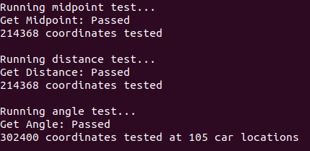
Physics Testing
Tom
Index 55
Index 170
Angle to Checkpoint Test
Loops representing car/checkpoint location and car angle
360 Index LUT -> Index = Angle -> Fast Mathless Verification
Math behind collision, distance from wall/checkpoint
We expect 170 - 55 = 115 degrees

Slide 5
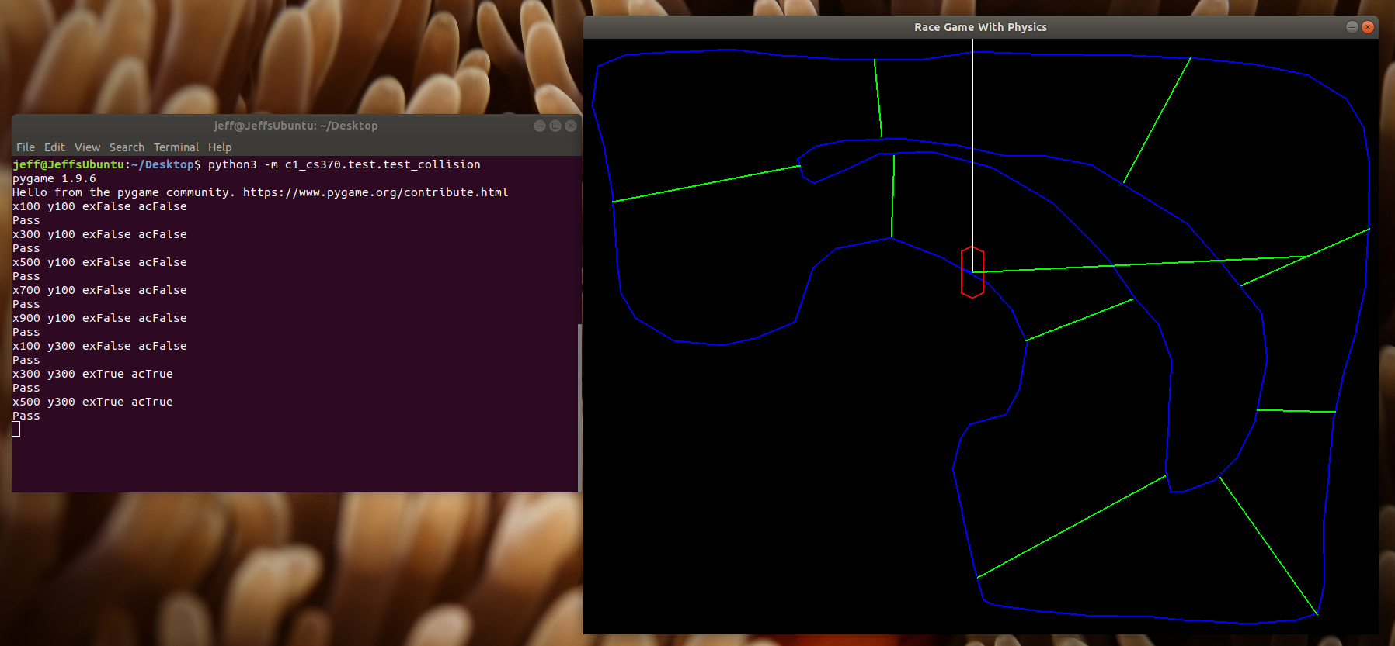
Checkpoint Test
Jeff
Teleports the car to predetermined locations and verifies checkpoint outputs when the car is teleported to checkpoint locations
This test passed every time
Collision test works the same way, fails at 1/20 test points
Debug next cycle

Slide 6
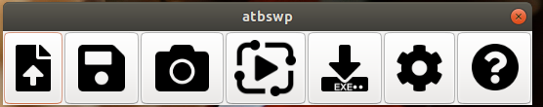
Map GUI testing
Jeff
Used ATBSWP: record/playback keyboard/mouse input
Writes commands to a text file

Slide 7
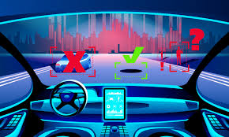
Updated AI Movement
Tim
Previously the AI car was checking several calculations every frame of the game causing unnecessary overhead. The user inputted codes also worked sporadically and had little consistency.
Now the AI gets most of the main calculations done before the game begins. Also the calculations were looked at for their consistency flaws and now the user’s commands work better with the AI.

Slide 8
DEMO

Slide 9

Process/Tools/Standards
Tim
BitBucket was used for code organization and management
Weekly Status Reports, hours and feature progress
Testing and code review of every completed feature

Slide 10
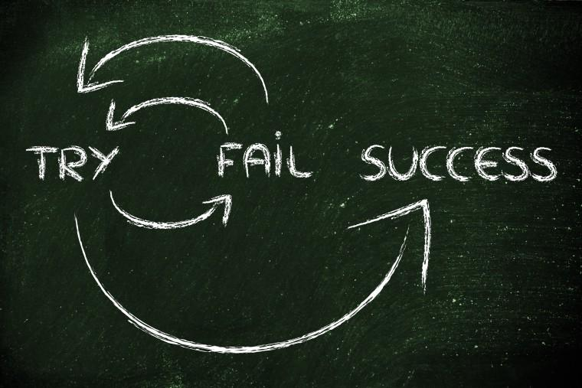
Lessons Learned
Nick
Even if everything appears to be working, there can be critical flaws that are unknown

Slide 11
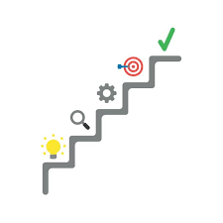
Next Steps
Nick
Finish and implement the AI and UI
Finish tests that were started
Perform code review on the code that passed in Cycle 2

